Slide 1
Chapter 8
Chapter 8
RMON
Network Management: Principles and Practice
© Mani Subramanian 2000
8-1

Slide 2
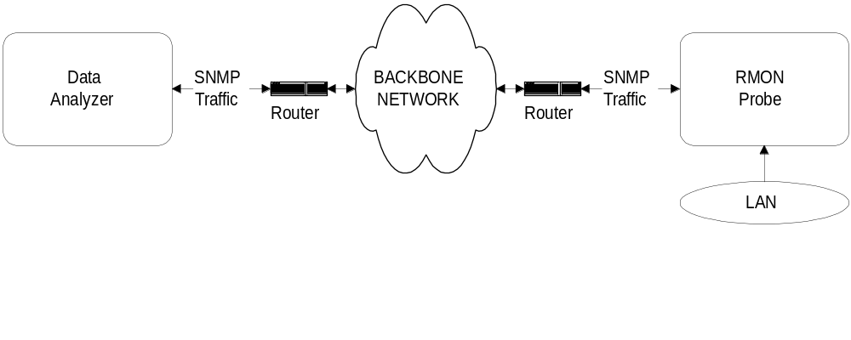
Chapter 8
RMON Components
RMON Probe
  Data gatherer - a physical device
Data analyzer
  Processor that analyzes data
  Notes
RMON Remote Network Monitoring
Network Management: Principles and Practice
© Mani Subramanian 2000
8-2

Slide 3
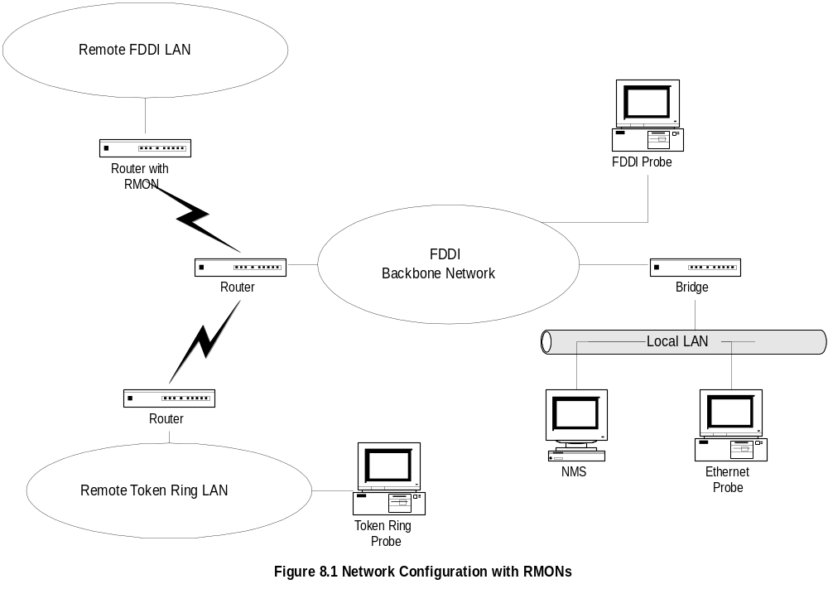
Chapter 8
Network with RMONs
  Nots
  Notes
Note that RMON is embedded monitoring remote
FDDI LAN
Analysis done in NMS
Network Management: Principles and Practice
© Mani Subramanian 2000
8-3

Slide 4
Chapter 8
RMON Benefits
Monitors and analyzes locally and relays data;
Less load on the network
Needs no direct visibility by NMS;
More reliable information
Permits monitoring on a more frequent basis
and hence faster fault diagnosis
Increases productivity for administrators
  Notes
Network Management: Principles and Practice
© Mani Subramanian 2000
8-4

Slide 5
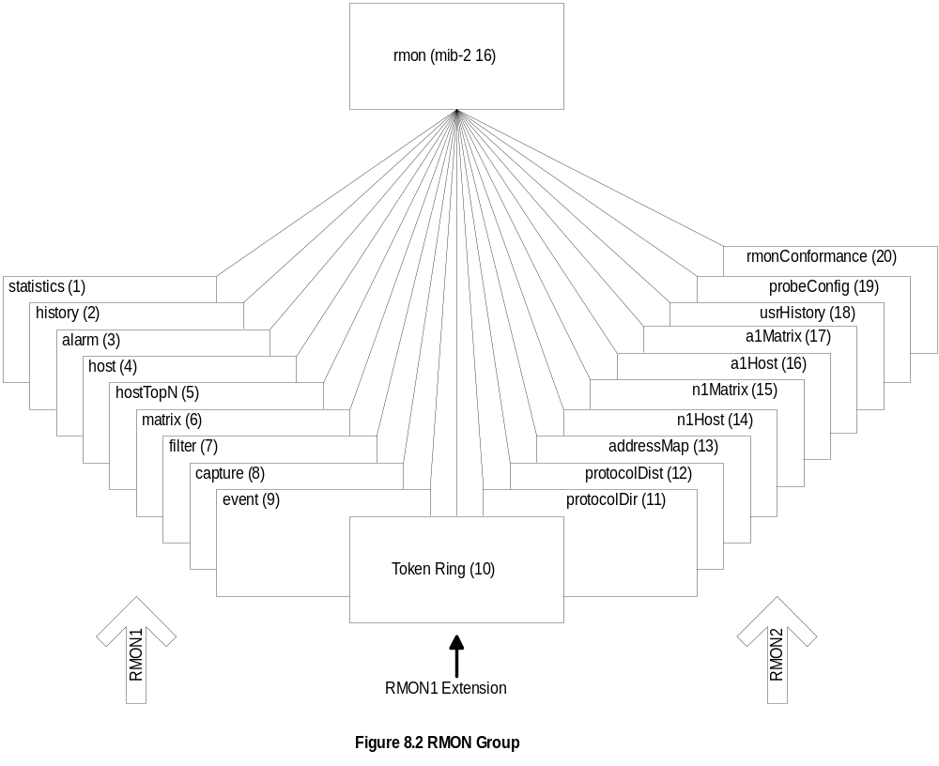
Chapter 8
RMON MIB
  Notes
RMON1: Ethernet RMON groups (rmon 1 - rmon 9)
RMON1: Extension: Token ring extension (rmon 10)
RMON2: Higher layers (3-7) groups (rmon 11 - rmon 20)
Network Management: Principles and Practice
© Mani Subramanian 2000
8-5

Slide 6
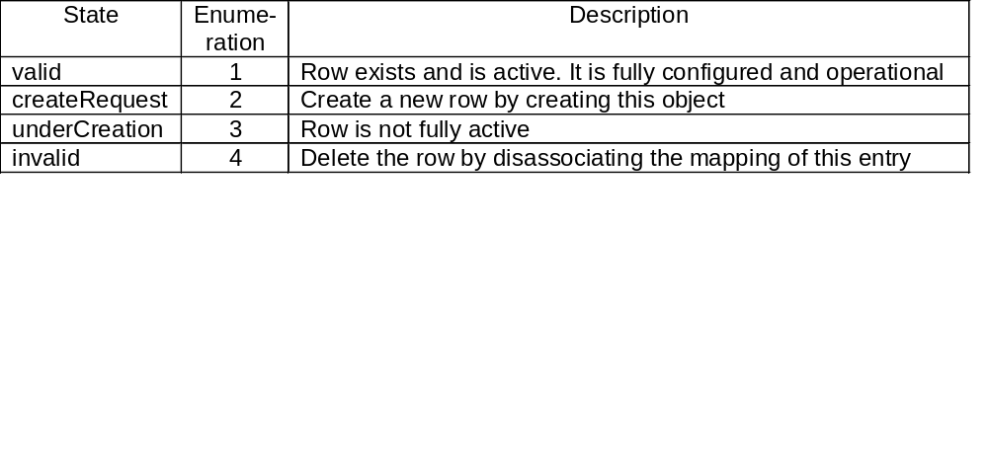
Chapter 8
Row Creation & Deletion
EntryStatus data type introduced in RMON
EntryStatus (similar to RowStatus in SNMPv2)
used to create and delete conceptual row.
Only 4 states in RMON compared to 6 in SNMPv2
  Notes
Network Management: Principles and Practice
© Mani Subramanian 2000
8-6

Slide 7
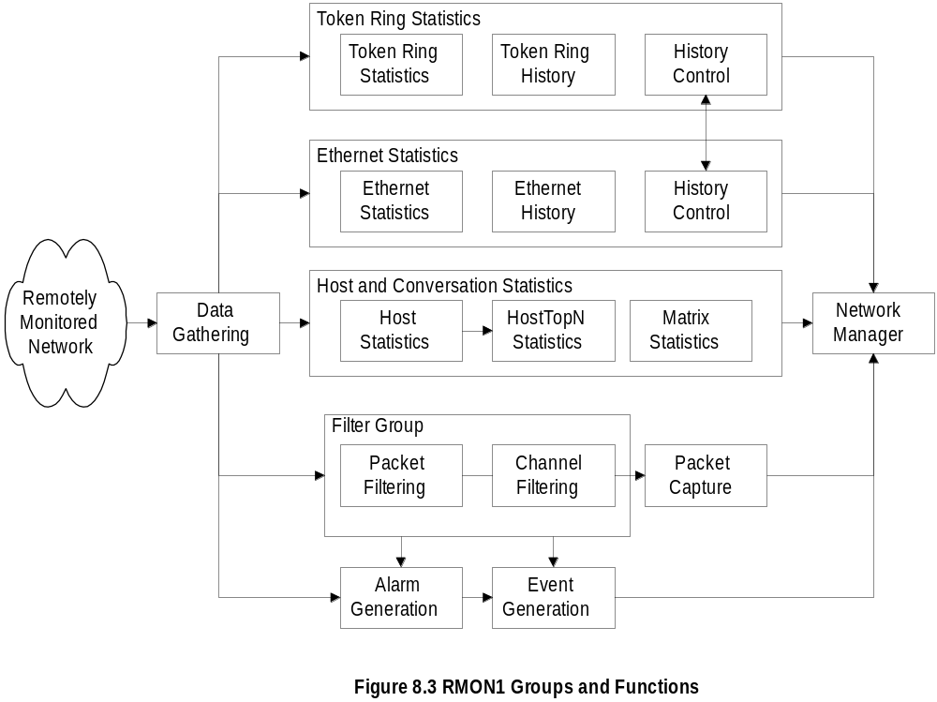
Chapter 8
RMON Groups and Functions
  Notes
Probe gathers data
Functions
  Statistics on Ethernet, token ring, and
  hosts / conversations
  Filter group filters data prior to capture of data
  Generation of alarms and events
Network Management: Principles and Practice
© Mani Subramanian 2000
8-7

Slide 8
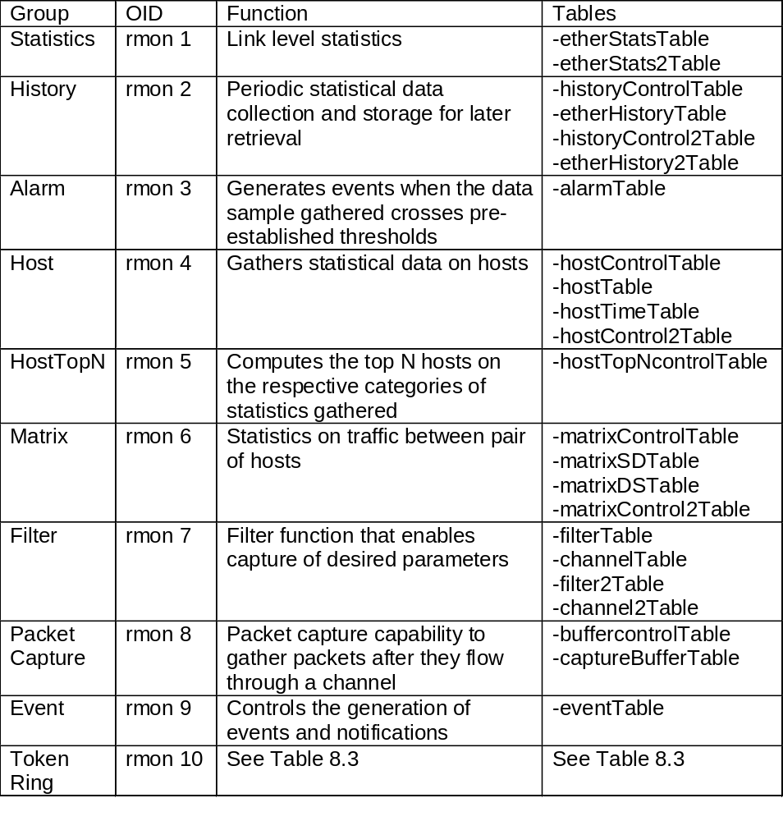
Chapter 8
RMON1 MIB Groups & Tables
  Notes
Ten groups divided into three categories
  Statistics groups (rmon 1, 2, 4, 5, 6, and 10))
  Event reporting groups (rmon 3 and 9)
  Filter and packet capture groups(romon 7 and 8)
Groups with “2” in the name are enhancements with RMON2
Network Management: Principles and Practice
© Mani Subramanian 2000
8-8

Slide 9
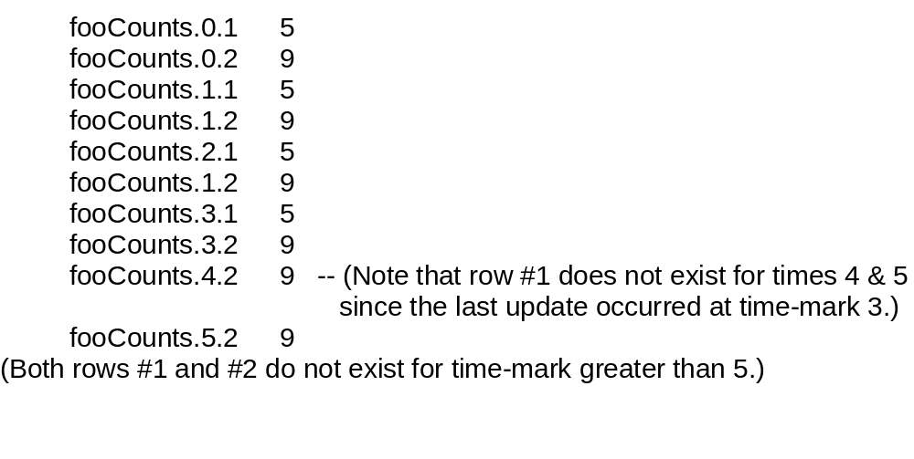
Chapter 8
Textual Convention:
LastCreateTime and TimeFilter
LastCreateTime tracks change of data with the
changes in control in the control tables
Timefilter used to download only those rows that
changed after a particular time
FooTable (bold indicating the indices):
fooTimeMark fooIndex fooCounts
  Notes
Bold objects (fooTimeMark and fooIndex) are
indices
Network Management: Principles and Practice
© Mani Subramanian 2000
8-9

Slide 10
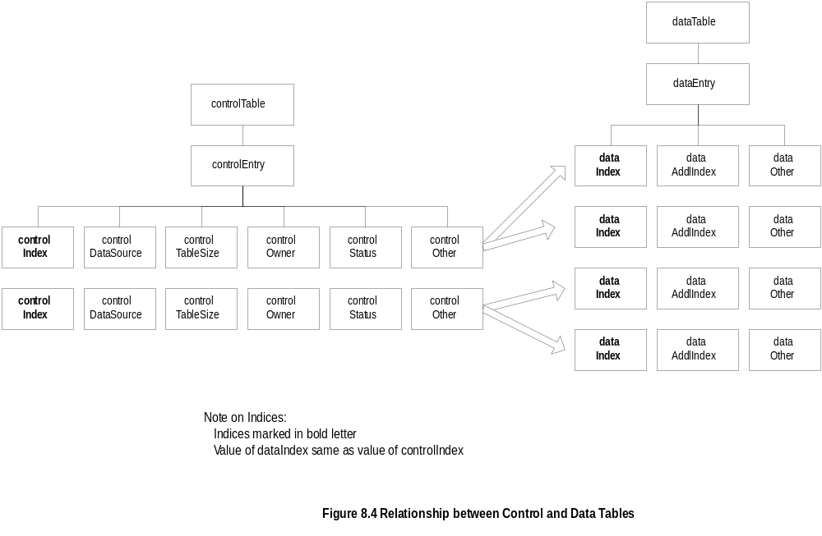
Chapter 8
Control and Data Tables
  Notes
Control table used to set the instances of data rows
in the data table
Values of data index and control index are the same
Network Management: Principles and Practice
© Mani Subramanian 2000
8-10

Slide 11
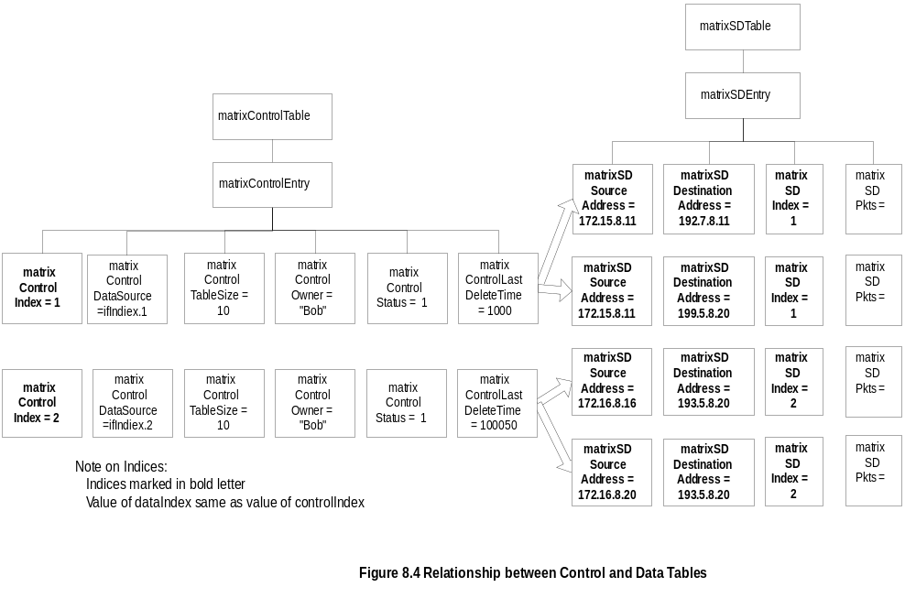
Chapter 8
Matrix Control and SD Tables
  Notes
matrixSDTable is the source-destination table
controlDataSource identifies the source of the data
controlTableSize identifies entries associated with
the data source
controlOwner is creator of the entry
Network Management: Principles and Practice
© Mani Subramanian 2000
8-11

Slide 12
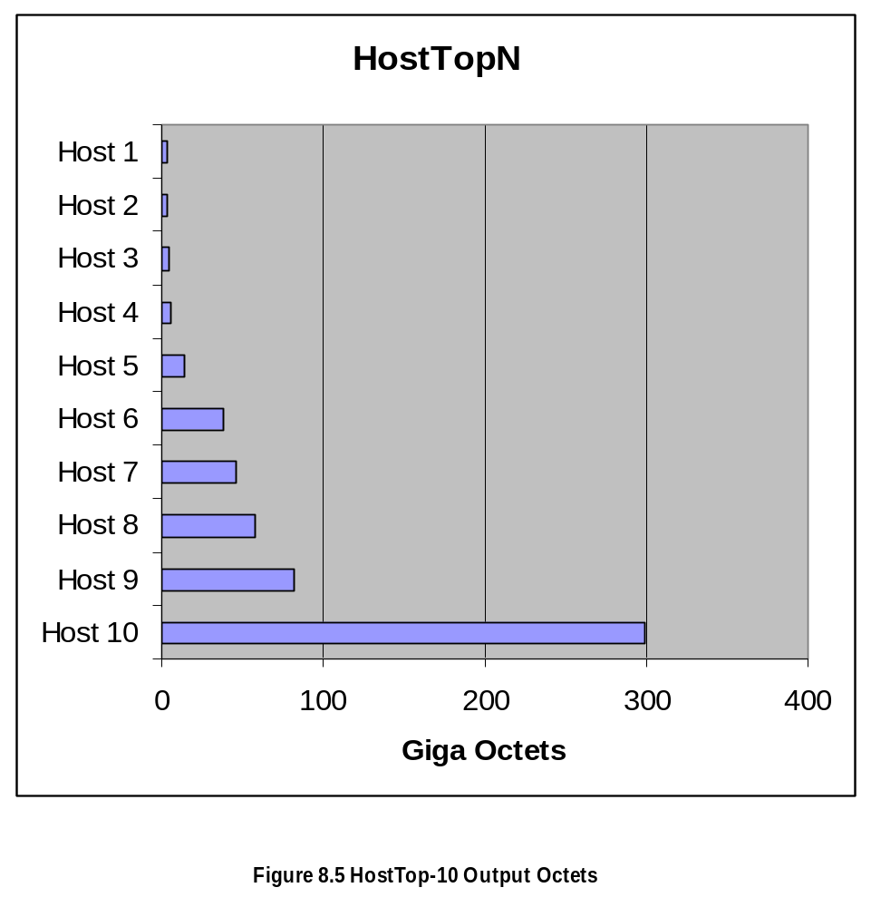
Chapter 8
Host Top N Group Example
  Notes
Network Management: Principles and Practice
© Mani Subramanian 2000
8-12

Slide 13
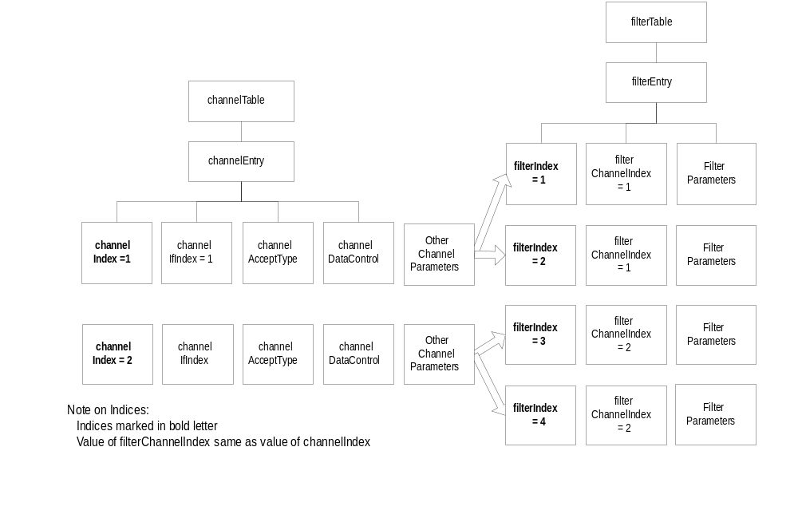
Chapter 8
Filter Group
  Notes
Filter group used to capture packets defined by
logical expressions
Channel is a stream of data captured based on a
logical expression
Filter table allows packets to be filtered with an
arbitrary filter expression
A row in the channel table associated with multiple
rows in the filter table
Network Management: Principles and Practice
© Mani Subramanian 2000
8-13

Slide 14
Chapter 8
Packet Capture Group
Channel
Table
Filter
Table
(many
for
each
channel)
Capture
Buffer
Table
(One
entry
per
Channel)
  Notes
Packet capture group is a post-filter group
Buffer control table used to select channels
Captured data stored in the capture buffer table
Network Management: Principles and Practice
© Mani Subramanian 2000
8-14

Slide 15
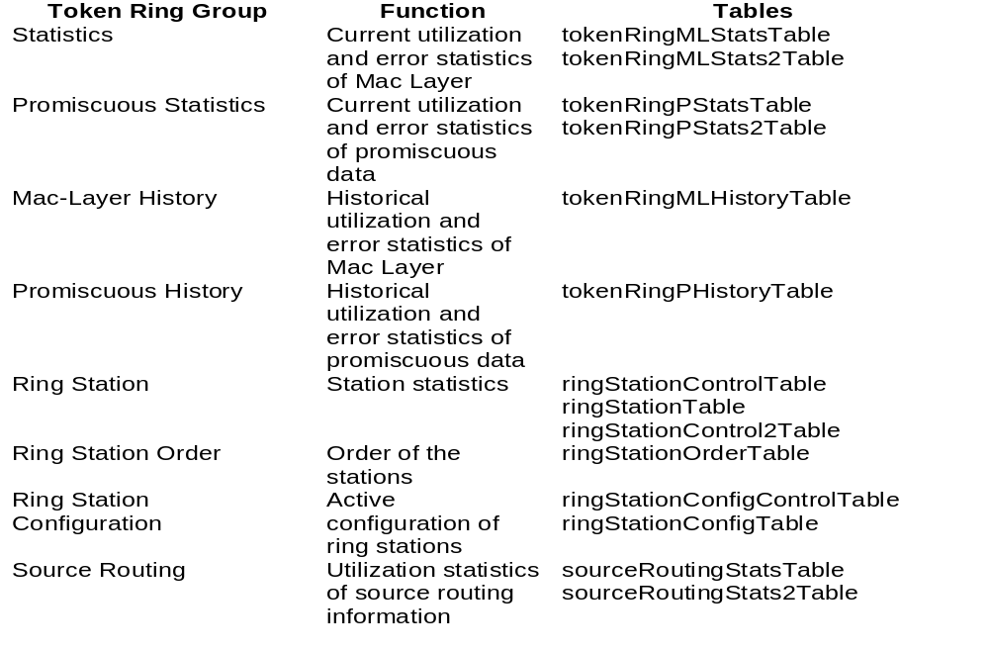
Chapter 8
RMON TR Extension Groups
  Notes
Two statistics groups and associated history groups
  MAC layer (Statistics group) collects
  TR parameters
  Promiscuous Statistics group collects packets
  promiscuously on sizes and types of packets
Three groups associated with the stations
Routing group gathers on routing
Network Management: Principles and Practice
© Mani Subramanian 2000
8-15

Slide 16
Chapter 8
RMON2
Applicable to Layers 3 and above
Functions similar to RMON1
Enhancement to RMON1
Defined conformance and compliance
  Notes
Network Management: Principles and Practice
© Mani Subramanian 2000
8-16

Slide 17
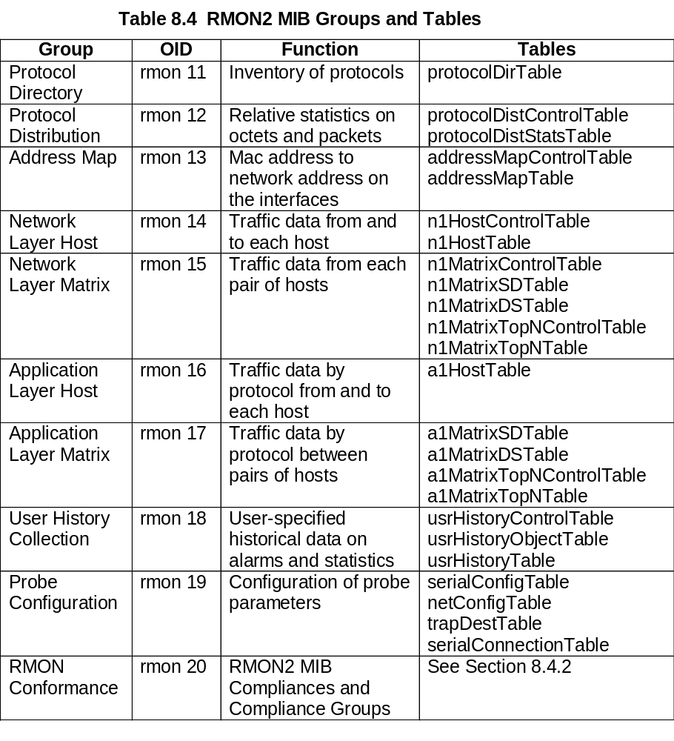
Chapter 8
RMON2 MIB
  Notes
Network Management: Principles and Practice
© Mani Subramanian 2000
8-17

Slide 18
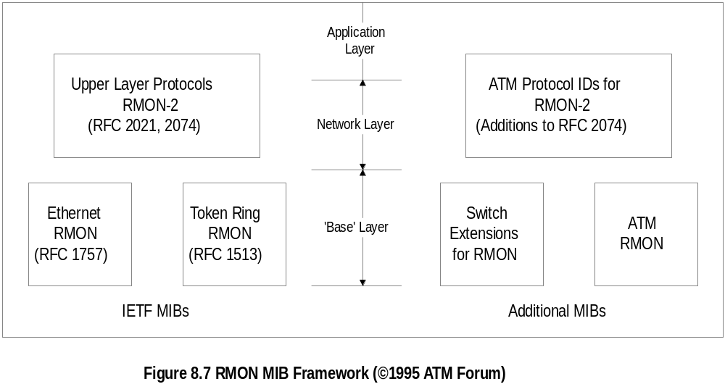
Chapter 8
ATM RMON
  Notes
ATM Forum extended RMON to ATM
Switch extensions and ATM RMON define objects
at the base layer
ATM protocol IDs for RMON2 define additional
objects at the higher levels
ATM devices require cell-based measurements and
statistics
Probe should be able to handle high speed
Network Management: Principles and Practice
© Mani Subramanian 2000
8-18

Slide 19
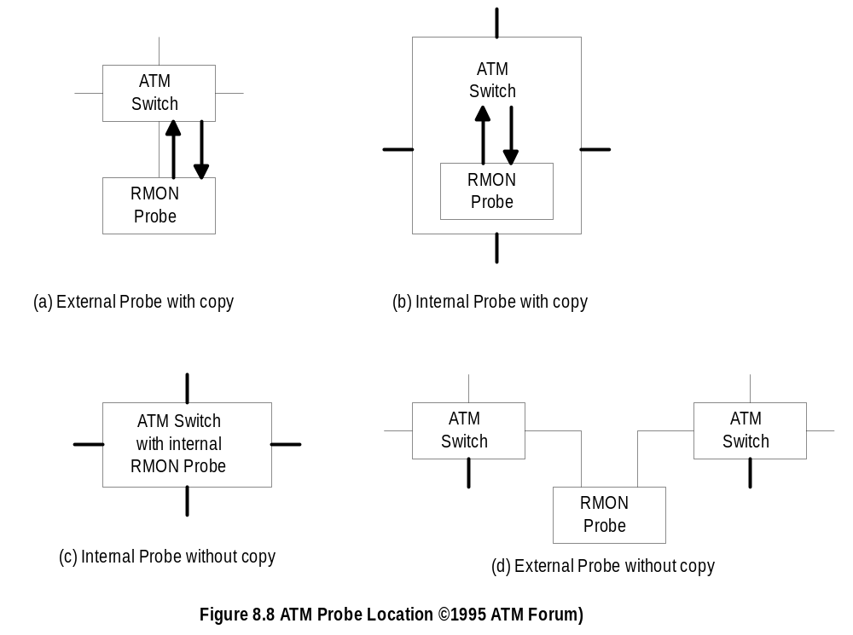
Chapter 8
ATM Probe Location
  Notes
Stand-alone probe in (a) copies the cells
Embedded version in (b) reports data, but
has no access to switch fabric
Internal probe (c) similar to (b) with access to switch
Stand-alone probe (d) taps network-to-network
interface between two ATM switches
(a) and (b) require duplex circuits, steering of traffic,
and design modification
Embedded designs (c) and (d) require no
modification
Network Management: Principles and Practice
© Mani Subramanian 2000
8-19

Slide 20
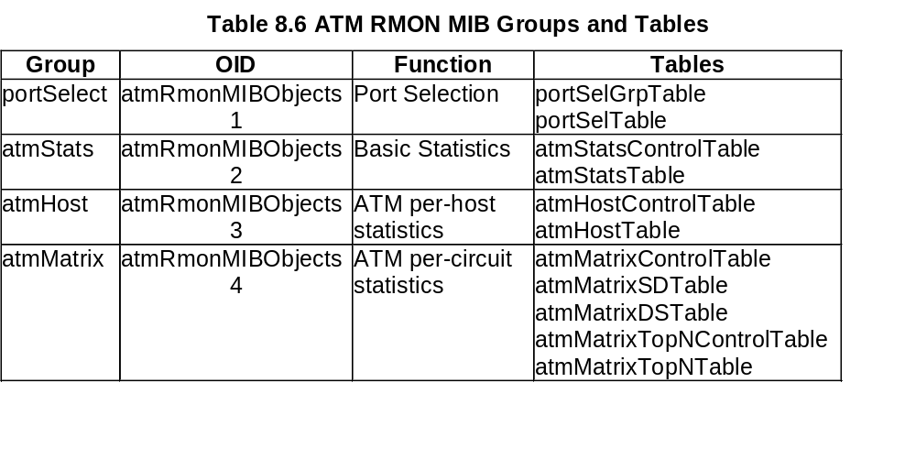
Chapter 8
ATM RMON MIB Groups
  Notes
ATM RMON MIB contains four groups
portSelect group selects ports
atmStats collects basic statistics based on port
selection
atmHost gathers statistics based on host traffic
atmMatrix group collects conversation traffic and
ranks the top-N entries
Network Management: Principles and Practice
© Mani Subramanian 2000
8-20

Slide 21
Chapter 8
A Case Study
A study at Georgia Tech on Internet traffic
Objectives
  Traffic growth and trend
  Traffic patterns
Network comprising Ethernet and FDDI LANs
Tools used
  HP Netmetrix protocol analyzer
  Special high-speed TCP dump tool for
  FDDI LAN
RMON groups utilized
  Host top-n
  Matrix group
  Filter group
  Packet capture group (for application level
  protocols)
  Notes
Network Management: Principles and Practice
© Mani Subramanian 2000
8-21

Slide 22
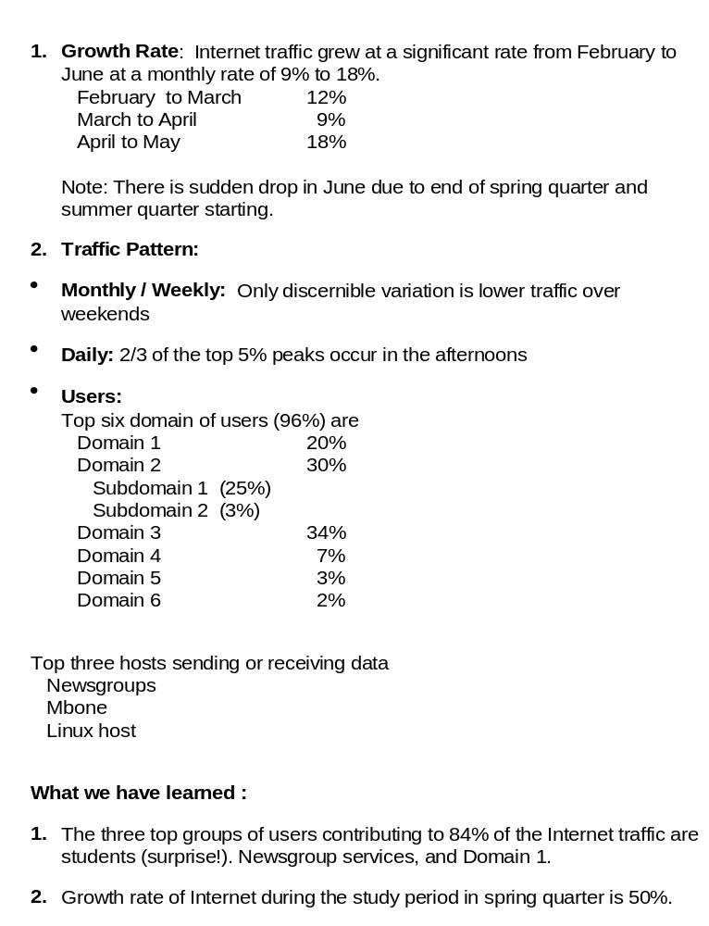
Chapter 8
Case Study Results
Network Management: Principles and Practice
© Mani Subramanian 2000
8-22

